Slide 1
Welcome to the May Congregation Meeting
May 2023

Slide 2
Agenda
Board of Directors Nominations – Scott Morris
Ministry Update – Dion Garrett
Financial Presentation – Dion Garrett & Matt Hewitt
Other Business – Scott Morris
Closing Prayer – Dion Garrett
Notes:
Scott

Slide 3
Board of Directors Update
Scott Morris
BOD President
Notes:
Good afternoon and hello to everyone. I am up here to quickly take you through the BOD nomination process before presenting the final slate of BOD to be elected for your approval.

Slide 4
Board Nomination Process
February – Board openings determined
March – Board skills/experience needs determined
March 5 to April 1 – Self nominations from congregation
April & May – Nominating Committee interviews and selection recommendation to Board
Notes:
From March 21 - April 1, we sought Board of Director Nominees from the Congregation with skills in; strategic leadership, consulting, marketing, or human resources background. The process by the committee including an evaluation of a candidate’s resume and skills against the needs the upcoming board, professional personality assessment, diversity, and an interviews.

Slide 5
Nominating Committee
Scott Morris Board of Directors
Annmarie Wallis Board of Directors
Matt Spanovich Congregation Member
Larry Kraus Congregation Member
Julie Lorenz Staff Liaison
Notes:
In accordance to the Constitution – A nominating committee to develop a slate of candidates for election to the Board of Directors, such committee to consist of two Board members and three non-Board members;

Slide 6
2022-23 Board of Directors
Jennifer Albritton Member at Large
Adam Bichsel Vice President
Matt Finke Treasurer
Dion Garrett Senior Pastor
Matt Hewitt Chief Operating Officer
Marla Maloney Member at Large*
Scott Morris President*
Damola Oshin Member at Large
David Pradhan Member at Large*
Beth Rusert Member at Large
Annmarie Wallis Secretary**
*Outgoing **Seeking Additional Term or Position
Notes:
A quick review of the current BOD, consist of 11 members which as you can see the following names and titles on the screen. In odd numbered years the following positions on the BOD are up for election: President, Secretary, and 2 of the 5 Members-At-Large.
As you can seein February we determined that we will have 3 outgoing Board members and 1 opting to re-up for another term. Leaving 3 positions to be filled as M-A-L.

Slide 7
2023-24 Board of Directors
Jennifer Albritton Member at Large
Adam Bichsel President**
Matt Finke Treasurer
Dion Garrett Senior Pastor
Matt Hewitt Chief Operating Officer
Damola Oshin Vice President**
Beth Rusert Member at Large
Annmarie Wallis Secretary**
OPEN Member at Large
OPEN Member at Large
OPEN Member at Large
**Seeking Additional Term or Position
Notes:
With the vacancy in the President position, the board of directors has recommended Adam Bichsel, the current vice-president, to step into the President position. Additionally, the board recommended that Damola Oshin succeed Adam in the role of Vice-President. According to Pathfinders current constitution, both of these positions must be filled by men.
Annmarie Wallis has agreed to serve another term as secretary of the board.
All of these moving pieces result in 3 open member-at-large positions.

Slide 8
Board of Directors Nominees
Adam Bichsel President**
Damola Oshin Vice-President**
Annmarie Wallis Secretary**
Becky Greer Member at Large
Craig McArton Member at Large
Eduardo Ramos Member at Large
**Seeking Additional Term or Position
Notes:
On behalf of the Nomination Committee I am presenting the following slate for election – see the summary sheet handout for more information about these candidates. Pathfinder Church is blessed by God for such talent and commitment.

Slide 9
Motion
To elect the Board of Directors nominee slate as presented for the upcoming fiscal year.
Adam Bichsel President**
Damola Oshin Vice-President**
Annmarie Wallis Secretary**
Becky Greer Member at Large
Craig McArton Member at Large
Eduardo Ramos Member at Large
**Seeking Additional Term or Position
Notes:
Scott:
1) “I will entertain a motion as presented” (wait for someone to move)
2) Ask for a second
3) Ask for any further discussion on the motion… give it adequate time for someone to get out the courage to bring up anything
4) If there’s no discussion or once the discussion has ended, call for a voice vote on the motion that’s on the table.

Slide 10
2023-24 Elders
Bob Ingle Chairman**
Michael Frith Vice Chairman
Dion Garrett Senior Pastor
Don Sternberg Secretary**
Bruce Litzsinger Elder**
Brian Olivio Elder
**Recently Appointed to Additional Term
Notes:
Dion – Just an FYI

Slide 11
Ministry Update
Dion Garrett
Senior Pastor

Slide 12
Pathfinder is Strong!
118 in Getting Started (9 shy of our all time record!)

Slide 13
May Getting Started Stories

Slide 14
Pathfinder is Strong!
118 in Getting Started (9 shy of our all time record!)
55 Baptisms.
In-person attendance is up 24% over last year (75% of pre-pandemic).
139 New Givers (up 18% from last year)

Slide 15
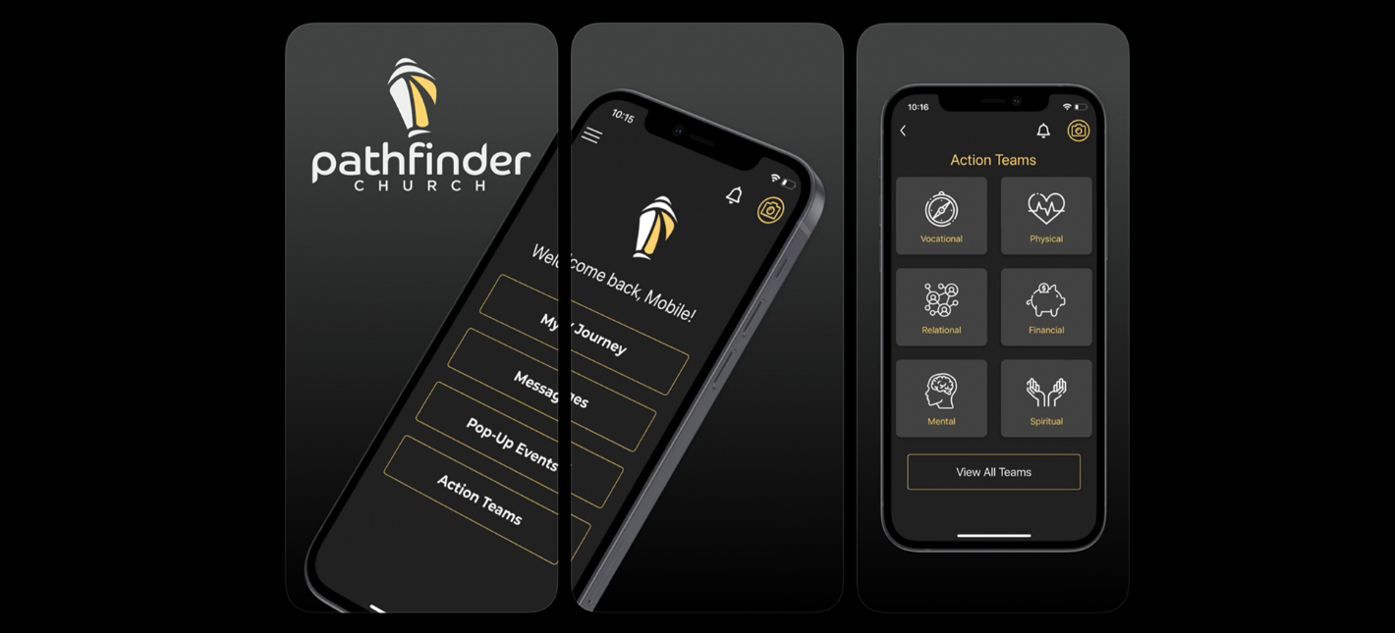
Action Teams & Whole Life

Slide 16
Increase outside awareness of our ministry
Continue wise technology investments
Steward our aging campus infrastructure
Focus our ministry on the “Whole Life” of Jesus
Coming to completion in December 2023!
Notes:
Dion

Slide 17
All signs point to a strong and healthy church, except giving.
Giving is 5% less than last year.

Slide 18
Ministry Fund Giving Trends
Notes:
Tracy

Slide 19
We have managed the current year giving shortfall very well.
We have cut over $700k in expenses from this year’s budget
We intend to finish (net results) better than budgeted.

Slide 20
In the year ahead, we are working to get giving back to 21/22 levels
Unfortunately, everything has gotten more expensive since then.
We are planning for a deficit in the next budget year, which will be funded with cash reserves.
Our goal is to get back to small surpluses in FY24/25

Slide 21
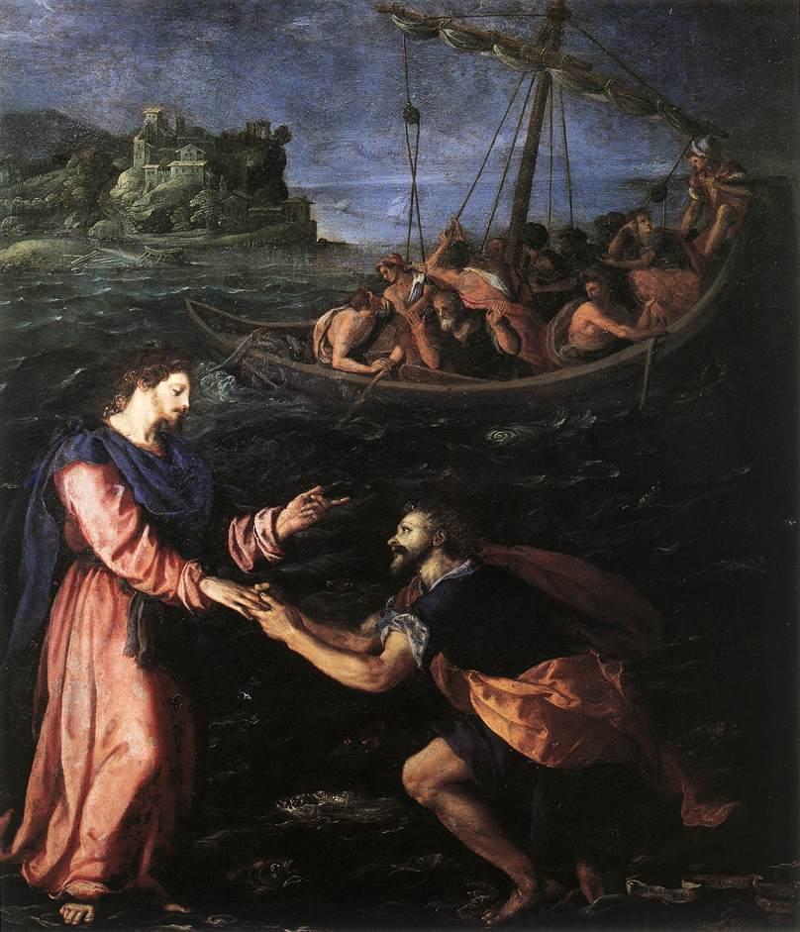
People of Faith Approach Life Differently

Slide 22
Financial Information
Dion Garrett
Senior Pastor
Matt Hewitt
Chief Operating Officer

Slide 23
Presentation Notes
Summary Presentation with amounts in thousands (000)’s
22/23 Forecast based upon actual results through April 2023
Year refers to the end of the Fiscal Year (June 30)
Notes:
Matt

Slide 24
Current Year Forecast

Slide 25
Current Year Forecast
Fund | Budget | Forecast | Difference
Ministry Fund | ($293) | ($149) | $144
School Fund | $11 | ($22) | ($33)
Total | ($282) | ($170) | $112
Notes:
Matt

Slide 26
Ministry Fund Forecast
Variances to Budget
Positive Variances
$398 Salary, Benefits, Taxes
$218 Delayed Capital Improvements
$53 Cancelled Furniture & Fixtures
$43 Delayed Flooring Supplies
Negative Variances
($629) Giving ($5M Budget)
*Other variances under $20,000 compose the remaining difference.
Notes:
Matt

Slide 27
School Fund Forecast
Variances to Budget
Positive Variances
$54 Delayed capital space improvements
Negative Variances
($65) Annual Fund giving
($50) More to scholarship fund
($22) South Wing/Gym boiler & pipe repairs
($20) Increased school lunch expense
*Other variances under $20,000 compose the remaining difference.
Notes:
Matt

Slide 28
Ministry Fund FY24 Budget

Slide 29
Ministry Fund FY24 Budget
 | FY 23/24 Budget | FY 22/23 Forecast | Favorable/ (Unfavorable)
General Offerings | $4,577 | $4,371 | $206
Ministry Expenses | ($2,494) | ($2,246) | ($248)
Operating Expenses | ($2,415) | ($2,274) | ($141)
TOTAL EXPENSES | ($4,909) | ($4,520) | ($389)
Surplus / (Deficit) | ($332) | ($149) | ($183)
Notes:
Matt – High Level

Slide 30
Ministry Fund FY24 Giving
Notes:
Matt – Touch on the analysis that went into determining giving target for next year.

Slide 31
Ministry Fund Budget Analysis
Notes:
Matt – Highlight that between salaries, facilities, and debt we’re at $4,059,997

Slide 32
Ministry Fund Upcoming Year
Income Changes over Forecast
$206 Giving Growth
$28 Investment Interest Income
Expense Changes over Forecast
$180 Staffing & Benefits Increases
$108 Capital Improvements
$37 Debt Payment Scheduled Increase
$24 Increase in Outsourced Janitorial
*Other variances under $20,000 compose the remaining difference.
Notes:
Matt – Touch on

Slide 33
School Fund 23/24 Budget
Notes:
Matt

Slide 34
School Fund FY24 Budget
 | FY 23/24 Budget | FY 22/23 Forecast | Favorable/ (Unfavorable)
Tuition K – 8th Grade | $1,728 | $1,796 | ($68)
Tuition EC | $1,009 | $960 | $49
Third Source & Other | $428 | $368 | $60
TOTAL INCOME | $3,165 | $3,124 | $41
EC- 8th Grade Expenses | ($2,158) | ($2,130) | ($28)
Administrative Expenses | ($731) | ($722) | ($9)
Other Expenses | ($282) | ($294) | $12
TOTAL EXPENSES | ($3,171) | ($3,146) | ($25)
Surplus / (Deficit) | ($6) | ($22) | $16
Notes:
Matt

Slide 35
School Fund FY24 Budget
Income Changes over Forecast
($19) EC – 8th grade Tuition
$64 Third Source Funding
($4) Childcare Income
Expense Changes over Forecast
$50 Salaries & Benefits
($23) Computer Equipment
($41) Space Improvements
($31) Security Systems
*Other variances under $20,000 compose the remaining difference.
Notes:
Matt

Slide 36
Enrollment Trends
Notes:
Matt

Slide 37
Financial Results
Note: FY17/18 & FY18/19 includes the release of $578k from Mission 24/7 as restricted funds to the Ministry Fund.
FY21/22 & FY22/23 excludes infrastructure capitalized on the balance sheet projected total of $1,712k with
additional debt approved by congregation.
Notes:
Matt/Dion

Slide 38
Congregation Approved Debt
May 2021: The congregation approved up to $1,500,000 of additional debt for capital infrastructure expenditures, with the financing of all outstanding debt to be extended to 10 years.
$750,000 of debt was taken in December 2021
$750,000 of debt was taken in November 2022
Notes:
Matt

Slide 39
Debt Outstanding
Balances are as of December 31st each year.
Payment of $525,000 scheduled for January 2024
Notes:
Matt

Slide 40
Questions?
Notes:
Dion / Matt / Scott as needed

Slide 41
Motion for Budget
Scott Morris
BOD President

Slide 42
Motion
To approve the FY23/24 budgets as presented
Ministry Fund deficit of ($332)
School Fund deficit of ($6)
Ministry Fund and School Fund budgets result in 47 days of cash on hand.
Notes:
Scott:
1) “I will entertain a motion to accept the budget as presented” (wait for someone to move)
2) Ask for a second
3) Ask for any further discussion on the motion… give it adequate time for someone to get out the courage to bring up anything
4) If there’s no discussion or once the discussion has ended, call for a voice vote on the motion that’s on the table.

Slide 43
Other Business
Scott Morris
BOD President

Slide 44
Additional Information
Check out our website for more information:
www.pathfinderstl.org/church-business
Board Reports including Financials Statements
Annual Audit Report
Congregational Meeting Slides

Slide 46
Closing Prayer
Dion Garrett
Senior Pastor

Slide 48
Appendicies

Slide 49
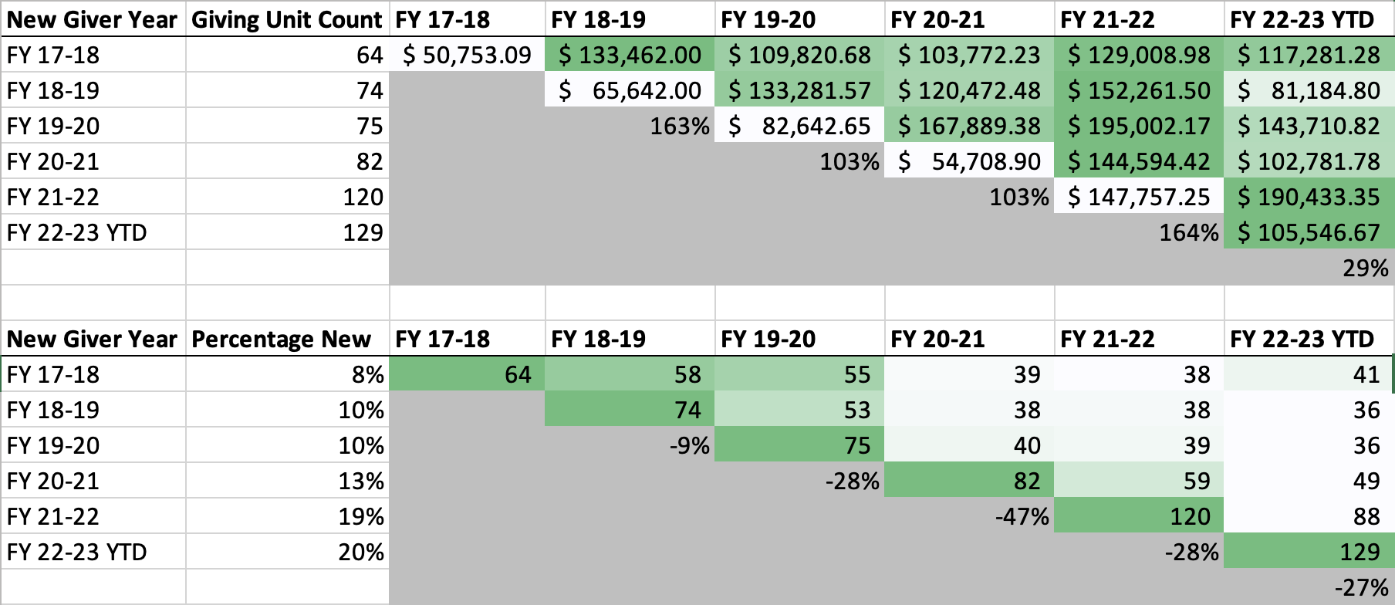
Appendix A – New Givers

Slide 50
Appendix B – Budget Levers
Already Cut from the Ministry Fund Budget
HR Associate (Budgeted in FY23 – Left Vacant)
Finance/Controller (Budgeted in FY23 – Left Vacant)
Conferences and Travel for Staff
Additional Budget Levers
Delay Capital Investments (MC Roof $105K – May)
Elect to continue using a Brand, Marketing, & Creative Contractor (Jan – June)
Notes:
Matt – Touch on

Slide 51
Campus Investments
Project | Original Projected Estimate | Final Project Cost
HVAC Units & Controls* | $1,200,000 | $1,138,520
Cornerstone Roof | $75,000 | $75,015
Fire, Security, and Phone Systems** | $117,000 | $212,446
Sanctuary Projectors | $220,000 | $243,590
South Wing Boiler/Gym AC | $75,000 | $99,882
Total | $1,687,000 | $1,769,453
* Rebates are offsetting costs for HVAC Units & Controls by $84K.
** Video security requires licensing for each camera. Pathfinder chose a 3-year license term,
which impacted cash on hand by $51,632.27 (with amortization over 36 months).
Years 2 and 3 of licensing are recorded as other assets on the balance sheet.

